Slide 1
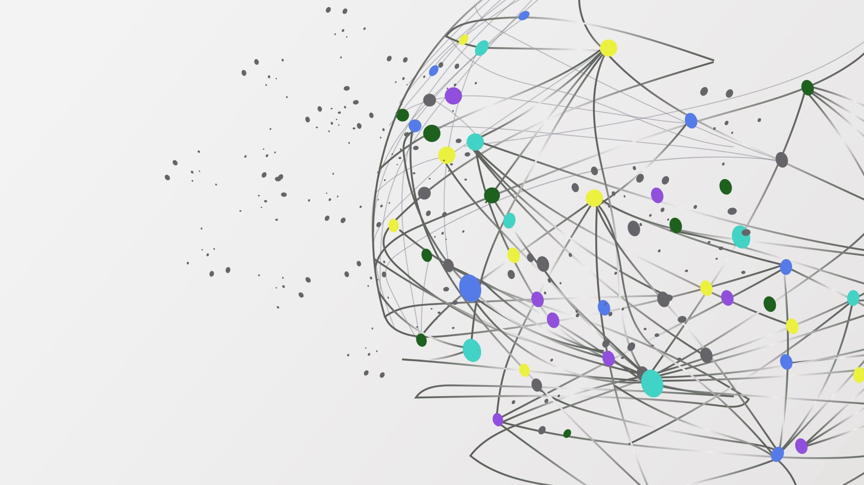
Objective 1.8 Section 1
Output Devices
Types and Functions

Slide 2
What is an output device?
Output devices are equipment used to get information or any other response out of the computer.
If the output can be read by human beings it is said to be human readable.
If the output cannot be understood by humans, it is said to be machine readable.
: - Display screens, speakers, printers, video graphics card, audio card (sound card) and plotters.
Types and Functions

Slide 3
Types of out put devices
Hardcopy
Softcopy
Hardcopy and Softcopy

Slide 4

Softcopy
Softcopy output is temporary output e.g. information displayed on a screen or in voice
or audio form through speakers.
This kind of output disappears when the computer is switched off since the screen or the speakers need the computer to work.

Slide 5

Hardcopy
Hardcopy output is permanent output e.g., information printed onto paper or film. It is tangible

Slide 6
Display Screens
Also called Monitors/Visual Display Units(VDU)
Used to output anything visual to the screen
Types:
Cathode Ry Rubes(CRT)
Flat Panel Display

Slide 7
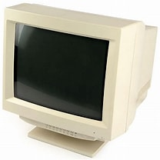
Cathode Ray Rude(CTR)
These have glass vacuum tubes into which an electron gun emits a flow of electrons guided by an electrical field towards a screen covered in small phosphorescent elements

Slide 8
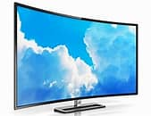
Flat Panel Display
:These screens are used mainly with portable computers like laptops, in some desktop computers and even in the latest television sets

Slide 9
Types of flat panel Displays
Liquid Crystal Display(LCD)
Plasma Display
Differences between the 2
LCD TV vs Plasma TV - Difference and Comparison | Diffen

Slide 10
Display Resolution
Screens can come in different sizes e.g. 14 inch or 17 inch. They can be either color or monochrome. Monochrome means black and white.
Images and text are formed by many tiny dots of colored light called pixels. A pixel is short for picture element. A pixel is the smallest unit on the display screen.
The number of pixels determines the resolution of the screen.

Slide 11
Common Resolutions
VGA (Video Graphics Array) = 640 x 480 pixels
SVGA (Super Video Graphics Array) = 800 x 600 pixels
XGA/XVGA (Extended Graphics Array/ Extended Video Graphics Array) = 1024 x 768 pixels
SXGA (Super Extended Graphics Array) = 1280 x 1024 pixels
UXGA (Ultra Extended Graphics Array) = 1600 x 1200 pixels
A video graphics card is also called a video display adapter. It determines the resolution, number of colors, and speed with which images appear on the screen.

Slide 12

Audio Output Devices
Speakers, headphones and earphones are used to output sound. The quality of the sound depends on the type of system used, the size of the speakers and the computer’s audio card. An audio card is used to process sound in the computer.

Slide 13
Hardcopy Output Devices - Printers
One way of classifying printers:
• Character printers: these print one character at a time similar to a typewriter.
They are slow.
• Line printers: They print a line at a time. Multiple hammer-like keys forming a line of text hit the page at one time.
They are much faster than character printers and are used to print large volumes. They print a limited number of characters and do not print graphics.
• Page printers: these print a whole page at a time. They are therefore even faster and deal with very large volumes of printed output.

Slide 14

Another way of classifying Printers:
Impact printers
Non-impact printers

Slide 15
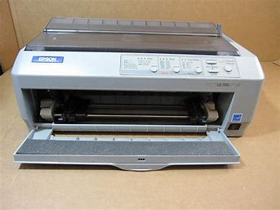
Impact Printers
Impact printers use a printing mechanism called a print head. They make their output by pressing the print head against a ribbon, which then hits the paper. The main types of impact printers are dot matrix, daisy wheel and drum, chain or band printers.

Slide 16
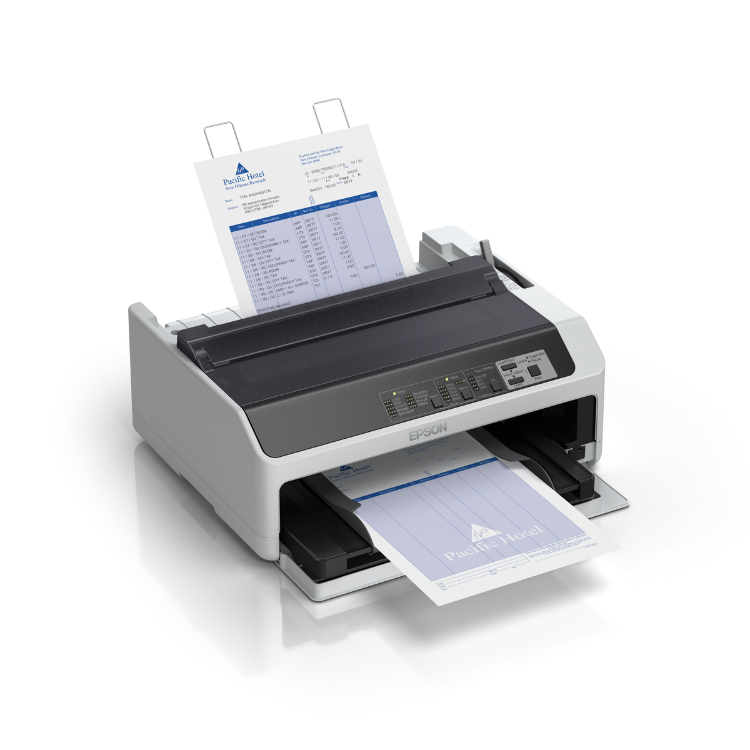
Dot Matrix printers
Characters are formed from a matrix of dots.
The speed is usually 30 – 550 characters per
second (cps)
It is very noisy
It is relatively fast
The print obtained is usually poor.
They are useful for low-quality carbon copy prints or printing on continuous sheets of paper e.g. invoices (bills).
They are not good for printing shaded graphics or photographs.

Slide 17
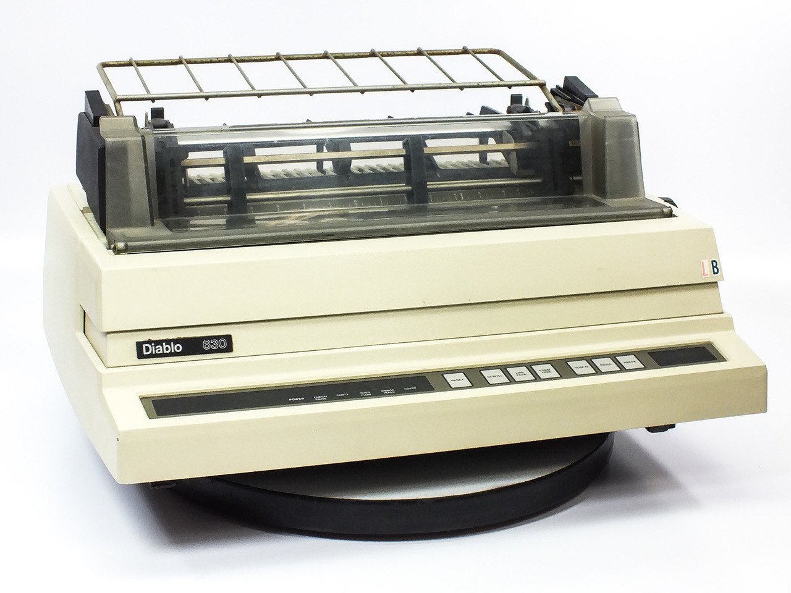
Daisy Wheel
It is very noisy
Printing is slow (less than 90 cps).
The text is generally crisp and clean.
The size and font produced can only be changed by using a different daisy, as the characters on the wheel are fixed.

Slide 18
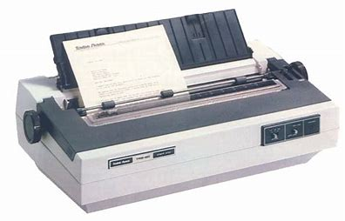
Drum, chain or brand printer(line printers)
They are fast (2500 lines per minute.
They are used to print large volumes of information.

Slide 19
Non-Impact Printers
Faster, quieter and produce better quality print than impact printers. Unlike the impact printer, the printing mechanism makes no contact with the paper. The main types of non-impact printers are laser printers, inkjet printers and thermal printers.

Slide 20

Thermal Printers
Types:- Direct Thermal and Thermal Wax Transfer Printer
Thermal printers are used in portable calculators, fax machines and some ATMs (automated teller machines).

Slide 21

Direct Thermal Printer
Uses heated pins to form the characters.
These pins come into contact with special heat-sensitive paper to form darkened dots when the pins reached a specific temperature
The pins actually burn the dots into the specially coated paper. Exposure to sunlight and heat tends to darken the thermal paper. The print quality is poor.

Slide 22
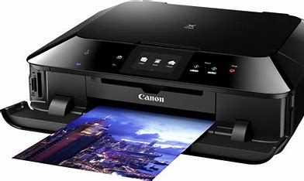
Inkjet Printers(line printers)
Inkjet printers produce their output by spraying small droplets of ink at high speed into paper, in a pattern.
These printers can print in both black-and-white and color. They used at home and small offices.
The print quality is good but not as good as the laser printer.
Inkjet printers can also produce both text and graphics. They are cheaper than laser printers.

Slide 23
Laser Printers(page printers)
These use a process similar to that of a photocopying machine.
They are used in large companies or institutions such as schools. They can also be found in modern offices.
A laser beam and dry powdered ink called toner produces a very fine dot matrix pattern.
This pattern is transferred to the page and then fused onto it by heat and pressure. These printers can print in black and white or colour.
These printers can produce more than 40 pages per minute (ppm).
The print quality is very good. Laser printers produce both text and graphics. They are very expensive.

Slide 24
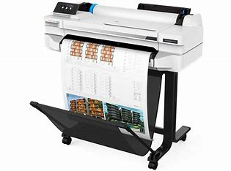
Plotters
Plotters use different printing processes e.g. some work like an inkjet printer and others use the same method as laser printers.
They are used to produce documents with high quality graphics in a variety of colours e.g. maps, architectural drawings and charts.
They can print on large sheets of paper.

Slide 25
Types of plotter printers
1. Pen Plotters:
These use a mechanical arm or rail that holds a pen which can be moved across the page.
2. Inkjet Plotter:
These work in the same way as inkjet printers by spraying ink onto the paper.
3. Electrostatic Plotter:
These work in the same way as laser printers.

Slide 26

Computer Output on Microfilm/Microfiche
COM is a method that is used to store computer documents by reducing them in size to fit on very small photographic sheets of film.
They are used to store large volumes of data. These sheets can be read using a special magnifying machine.
Microfilm is a roll of film and microfiche is a rectangular sheet of film on which many frames/pages of information can be stored.

